Slide 1
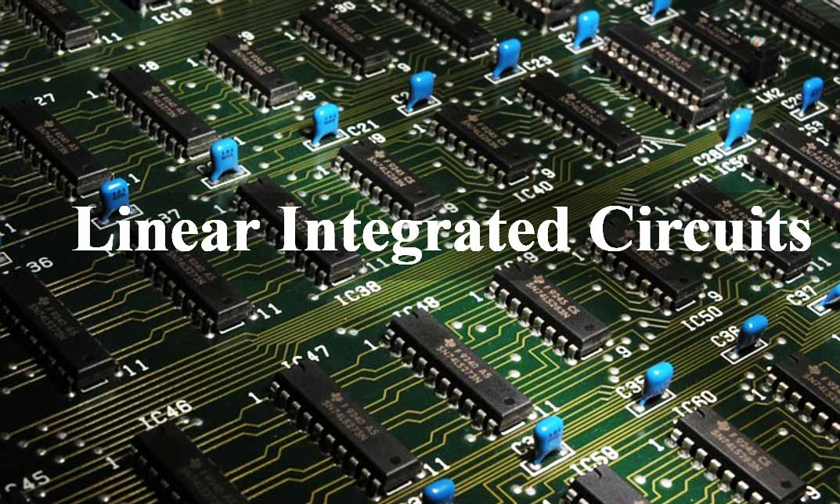
15EC502 – Linear Integrated Circuits

Slide 2
UNIT V - WAVEFORM GENERATORS AND SPECIAL FUNCTION ICs
Timer IC 555
ICL8038 Function Generator
IC Voltage Regulators
LM317 Three Terminal Fixed and Adjustable Voltage Regulators
IC 723 General Purpose Regulator
Switching Regulators, Monolithic Switching Regulator
Switched Capacitor Filter IC MF10
Frequency to Voltage and Voltage to Frequency Converters
Audio Power Amplifier
Video Amplifier.

Slide 3
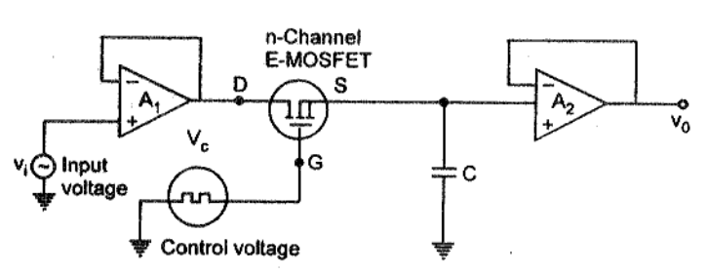
Sample and Hold Circuits
Circuit Diagram

Slide 4
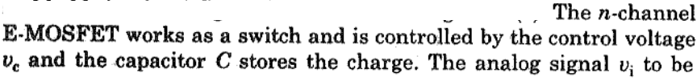
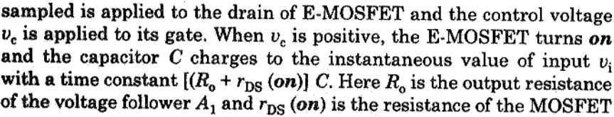
Sample and Hold Circuits
Working

Slide 5
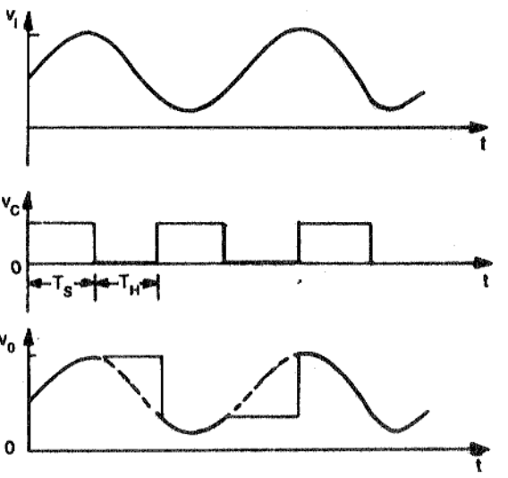
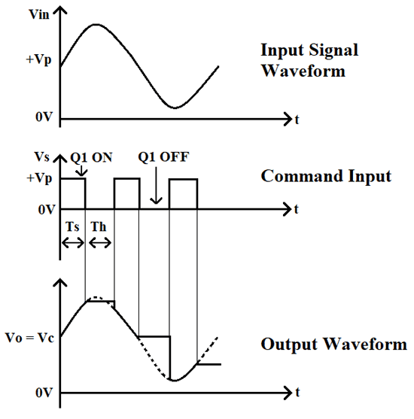
Sample and Hold Circuits
Waveform

Slide 6
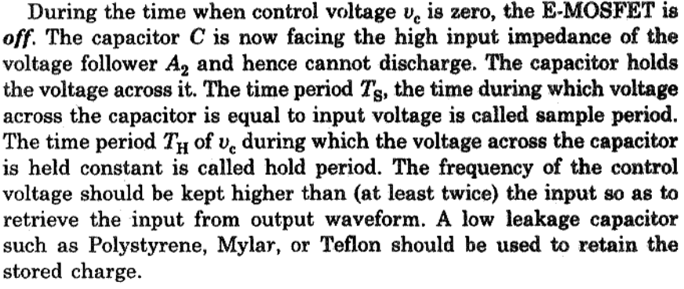
Sample and Hold Circuits
Working

Slide 7
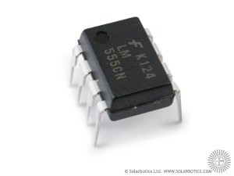
555 Timer
General
A Timer IC introduced by Signetics Corporation in 1970’s and gave the name SE/NE 555 timer.
The 555IC is reliable and is cheap in cost.
Its applications are monostable multivibrator and astable multivibrator.
A 555 timer can also be used in dc-dc converters, digital logic probes, waveform generators, analog frequency meters and tachometers, temperature measurement and control devices, voltage regulators etc
The timer IC is set up to work in either of the two modes – one-shot or monostable or as a free-running or astable multivibrator.
The SE 555 can be used for temperature ranges between – 55°C to 125°. The NE 555 can be used for a temperature range between 0° to 70°C.

Slide 8
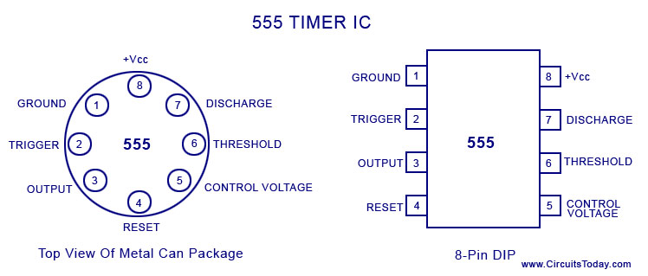
555 Timer
Pin Diagram

Slide 9
555 Timer
Pin Diagram
Pin 1. – Ground, The ground pin connects the 555 timer to the negative (0v) supply rail.
Pin 2. – Trigger, The negative input to comparator No 1. A negative pulse on this pin “sets” the internal Flip-flop when the voltage drops below 1/3Vcc causing the output to switch from a “LOW” to a “HIGH” state.
Pin 3. – Output, The output pin can drive any TTL circuit
Pin 4. – Reset, This pin is used to “reset” the internal Flip-flop controlling the state of the output, pin 3. This is an active-low input and is generally connected to a logic “1” level when not used to prevent any unwanted resetting of the output.
Pin 5. – Control Voltage, This pin controls the timing of the 555 by overriding the 2/3Vcc level of the voltage divider network. By applying a voltage to this pin the width of the output signal can be varied independently of the RC timing network. When not used it is connected to ground via a 10nF capacitor to eliminate any noise.
Pin 6. – Threshold, The positive input to comparator No 2. This pin is used to reset the Flip-flop when the voltage applied to it exceeds 2/3Vcc causing the output to switch from “HIGH” to “LOW” state. This pin connects directly to the RC timing circuit.
Pin 7. – Discharge, The discharge pin is connected directly to the Collector of an internal NPN transistor which is used to “discharge” the timing capacitor to ground when the output at pin 3 switches “LOW”.
Pin 8. – Supply +Vcc, This is the power supply pin and for general purpose TTL 555 timers is between 5V and 15V.

Slide 10
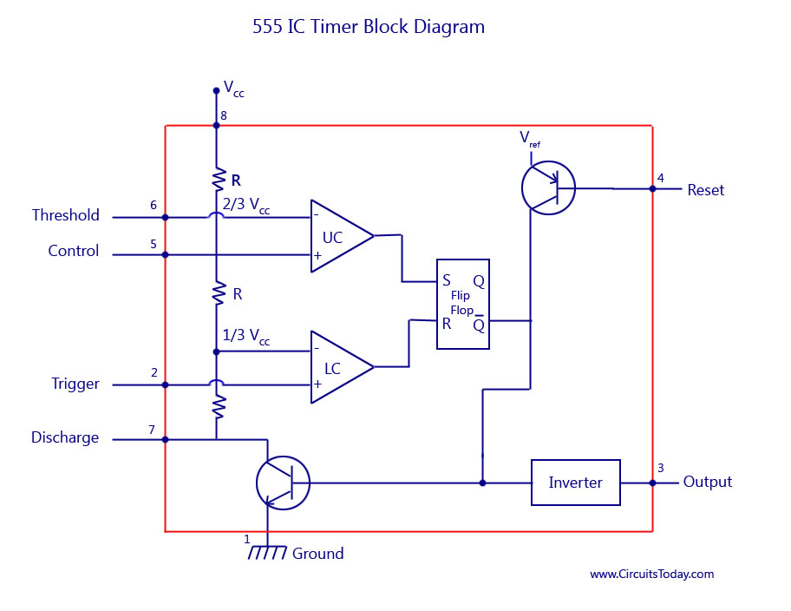
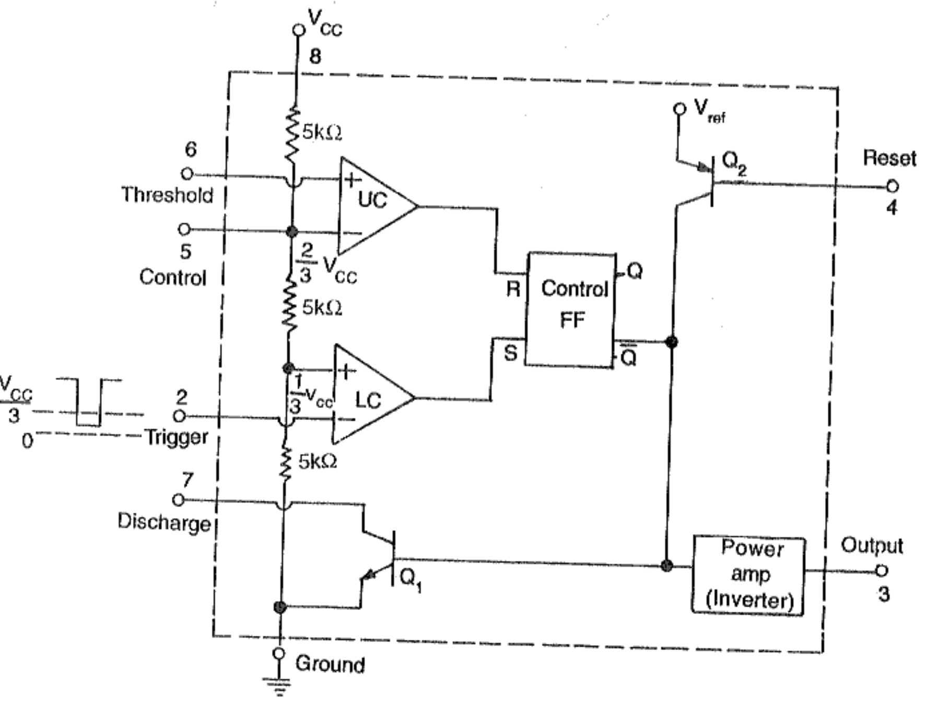
555 Timer
Block Diagram

Slide 11
555 Timer
Functional Description
The 555 Timers name comes from the fact that there are three 5kΩ resistors connected together internally producing a voltage divider network between the supply voltage at pin 8 and ground at pin 1.
The voltage across this series resistive network holds the negative inverting input of comparator two at 2/3Vcc and the positive non-inverting input to comparator one at 1/3Vcc.
The two comparators produce an output voltage dependent upon the voltage difference at their inputs which is determined by the charging and discharging action of the externally connected RC network.
The outputs from both comparators are connected to the two inputs of the flip-flop which in turn produces either a “HIGH” or “LOW” level output at Q based on the states of its inputs.
The output from the flip-flop is used to control a high current output switching stage to drive the connected load producing either a “HIGH” or “LOW” voltage level at the output pin.

Slide 12

555 Timer - Monostable Multivibrator
Diagram

Slide 13
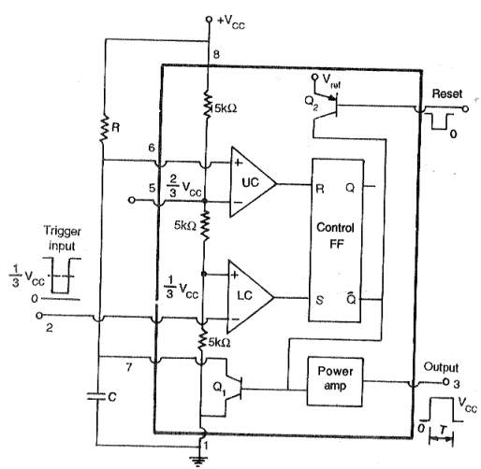
555 Timer - Monostable Multivibrator
Circuit Diagram

Slide 14
555 Timer - Monostable Multivibrator
Functional Description
When a negative (0V) pulse is applied to the trigger input (pin 2) of the Monostable configured 555 Timer oscillator, the internal comparator, (comparator No1) detects this input and “sets” the state of the flip-flop, changing the output from a “LOW” state to a “HIGH” state. This action in turn turns “OFF” the discharge transistor (Q1) connected to pin 7, thereby removing the short circuit across the external timing capacitor, C₁.
This action allows the timing capacitor (C₁) to start to charge up through resistor, R1 until the voltage across the capacitor reaches the threshold (pin 6) voltage of 2/3Vcc set up by the internal voltage divider network.
At this point the comparators output goes “HIGH” and “resets” the flip-flop back to its original state which in turn turns “ON” the transistor and discharges the capacitor to ground through pin 7. This causes the output to change its state back to the original stable “LOW” value awaiting another trigger pulse to start the timing process over again. Then as before, the Monostable Multivibrator has only “ONE” stable state.
The Monostable 555 Timer circuit triggers on a negative-going pulse applied to pin 2 and this trigger pulse must be much shorter than the output pulse width allowing time for the timing capacitor to charge and then discharge fully.
Once triggered, the 555 Monostable will remain in this “HIGH” unstable output state until the time period set up by the R₁ x C₁ network has elapsed.

Slide 15
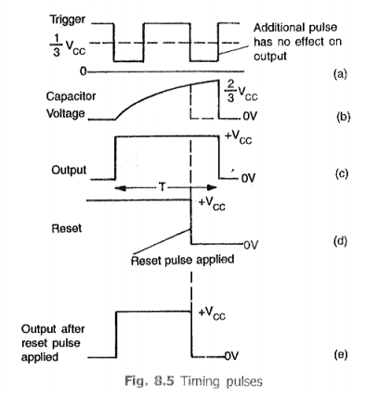
555 Timer - Monostable Multivibrator
Timing Diagrams

Slide 16
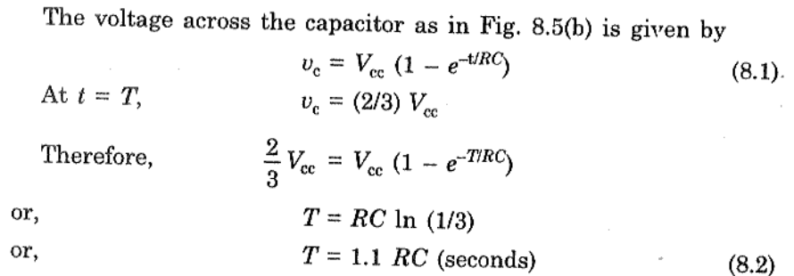
555 Timer - Monostable Multivibrator
Timing Calculation

Slide 17
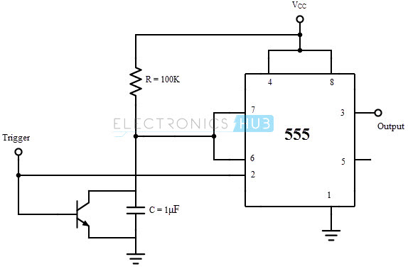
555 Timer - Monostable Multivibrator - Applications
Missing Pulse Detector

Slide 18
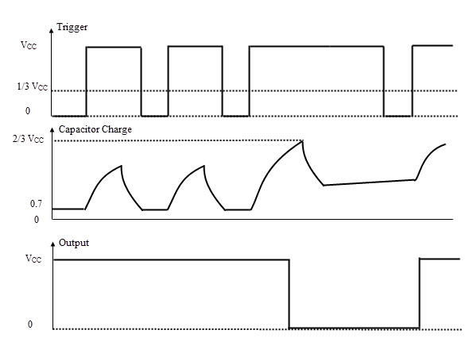
555 Timer - Monostable Multivibrator - Applications
Missing Pulse Detector

Slide 19
555 Timer - Monostable Multivibrator - Applications
Missing Pulse Detector
A PNP transistor is connected across the capacitor and the input trigger pulse train is given to the base terminal of the transistor as well as the pin 2 trigger input of the IC 555.
The train of trigger pulses will continuously reset the timing cycle. Hence the output is always high. If any trigger pulse is missing, the device detects this missing pulse and the output goes low.
When the input is 0, the PNP transistor is turned ON and the voltage across the capacitor is clamped to 0.7 V and the output is HIGH. When the input trigger voltage is high, the transistor is cut-off and the capacitor will start charging.
If the input trigger signal goes low again before the completion of the timing cycle, the voltage across the capacitor falls to 0.7 V before reaching the threshold voltage (2/3 VCC) and the output continues to remain HIGH.
If the input trigger signal doesn’t go low before the completion of the timing cycle due to a missing pulse, it allows the capacitor to charge to the threshold voltage and the output will become LOW.
In order to make this circuit work as a Missing Pulse Detector, the time period of the input trigger signal should be slightly lesser than the timing interval. Because of this, the continuous negative going input pulses will not allow the capacitor to charge till the threshold voltage. And the output continues to stay high. In case of change of input frequency or a missing pulse, the capacitor will charge to the threshold voltage and the output falls low.

Slide 20
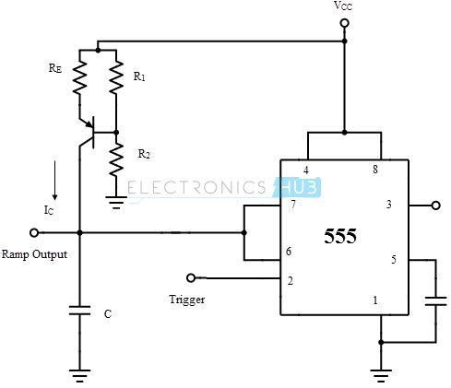
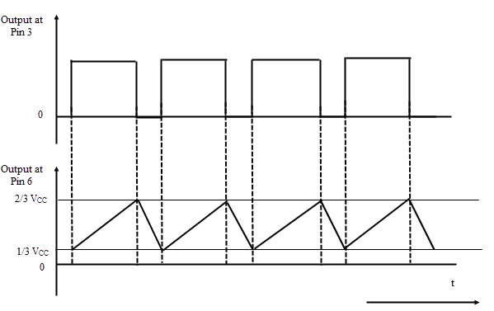
555 Timer - Monostable Multivibrator - Applications
Linear Ramp Generator

Slide 21
555 Timer - Monostable Multivibrator - Applications
Linear Ramp Generator
The monostable multivibrator will act as a Linear Ramp Generator with the addition of a constant current source. A current mirror, consisting of a diode and a PNP transistor, is used as a Constant Current Source. This constant current source is positioned in place of the timing resistor.
The current IC from the constant current source will charge the capacitor at a constant rate towards the peak voltage (V_{CC}) resulting in a rising linear ramp. As the voltage across the capacitor reaches 2/3 V_{CC}, the comparator 1 will drive the discharge transistor to saturation. As a result, the capacitor starts discharging. While discharging, as the voltage across the capacitor falls to 1/3 V_{CC}, the comparator 2 will turn off the discharge capacitor.
Hence the capacitor will start charging again. The discharge time of the capacitor is very less when compared to the charging time. As a result, the downward ramp is very steep (almost an immediate discharge).
The time period of the ramp output is approximately given by
T = (2/(3 ) Vcc Re (R1+R2)C)/(R1 Vcc – Vbe (R1+R2))

Slide 22
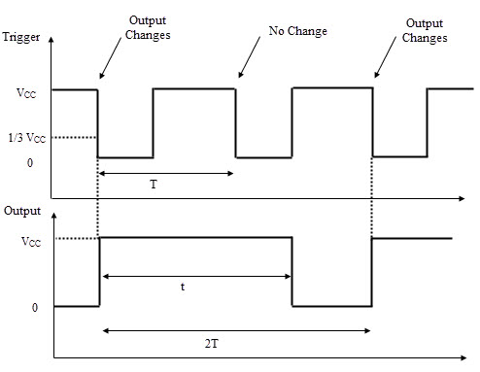
555 Timer - Monostable Multivibrator - Applications
Frequency Divider

Slide 23
555 Timer - Monostable Multivibrator - Applications
Frequency Divider
When the IC 555 is used as a monostable multivibrator, a positive going rectangular pulse is available at the output when a negative going pulse of short duration is applied at the trigger input.
By adjusting the time interval t of the charging or timing circuit the device can be made to work as a Frequency Divider circuit.
If the timing interval t is made slightly larger than the time period of the input pulse (trigger pulse), the device can act as a Divide – by – two circuit.
The timing interval can be controlled by appropriately choosing the values of the resistor R and the capacitor C in the timing circuit.
The circuit will trigger for the first negative pulse of the trigger input. As a result, the output will go to high state. The output will remain high for the time interval t.
During this interval, even if a second negative going trigger pulse is applied, the output will not be affected and continues to remain high as the timing interval is greater than the time period of the trigger pulse. On the third negative going trigger pulse, the circuit is retriggered.
So the circuit will trigger on every alternate negative going trigger pulse i.e. there is one output pulse for every two input pulses and hence it is a divide–by–two circuit.

Slide 24
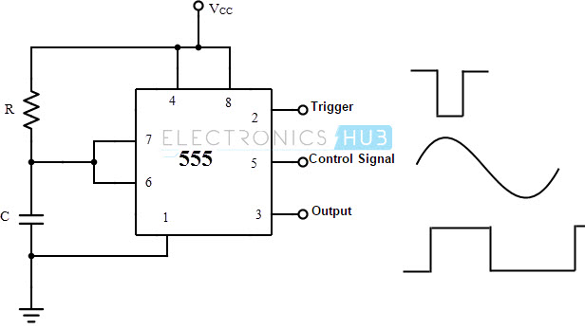
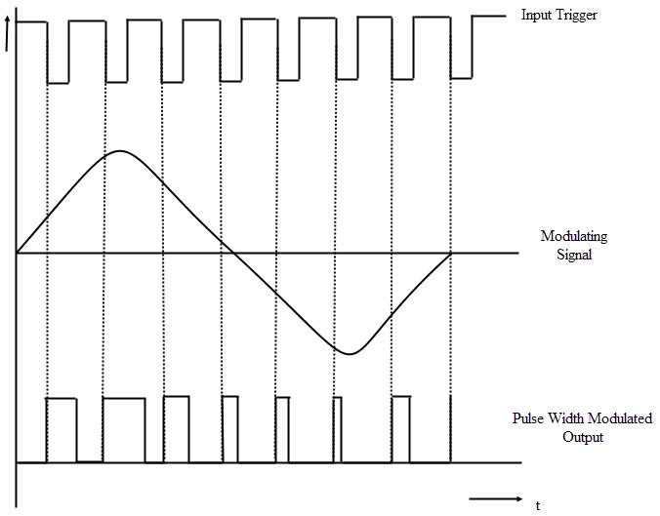
555 Timer - Monostable Multivibrator - Applications
Pulse Width Modulation

Slide 25
555 Timer - Monostable Multivibrator - Applications
Pulse Width Modulation
The monostable mode of operation of the IC 555 can be turned into a Pulse Width Modulator by applying a modulating signal as the control voltage at the pin 5.
The control signal will modulate the threshold voltage and as a result, the output pulse width is modulated. As the control voltage varies, the threshold voltage; which is the input to the comparator 1, also varies. As a result, the time for charging the capacitor to the threshold voltage level will vary, resulting in a pulse width modulated wave at the output.
Due to the application of the control signal, the upper threshold voltage level for the capacitor will be different. The new upper threshold level UTL is given by
UTL = 2/3 VCC + VMOD
Where VMOD is the voltage of the modulating signal

Slide 26
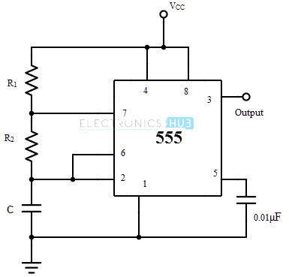
555 Timer - Astable Multivibrator
Schematic Diagram

Slide 27
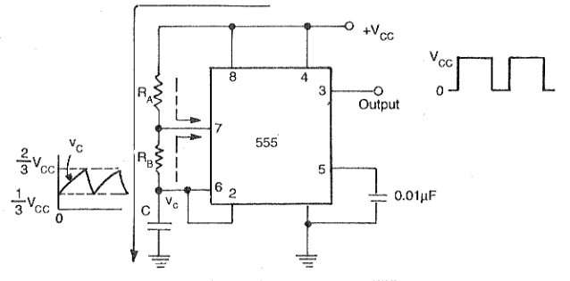
555 Timer - Astable Multivibrator
Schematic Diagram

Slide 28
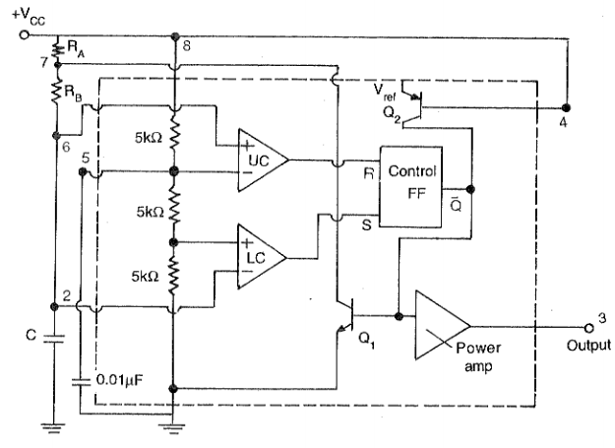
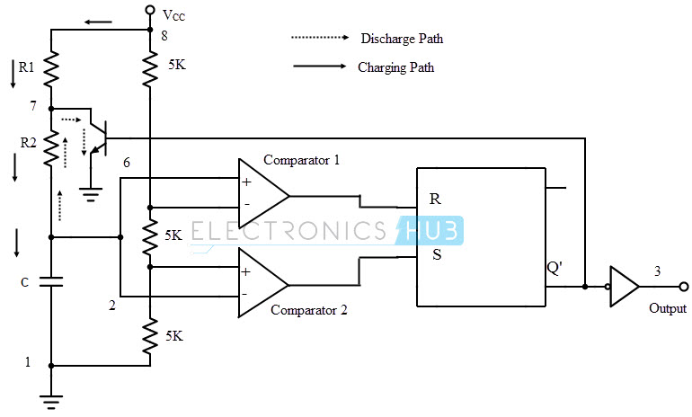
555 Timer - Astable Multivibrator
Circuit Diagram

Slide 29
555 Timer - Astable Multivibrator
Description
Astable multivibrator is also called as Free Running Multivibrator. It has no stable states and continuously switches between the two states without application of any external trigger. The IC 555 can be made to work as an astable multivibrator with the addition of three external components: two resistors (R1 and R2) and a capacitor (C).
The pins 2 and 6 are connected and hence there is no need for an external trigger pulse. It will self trigger and act as a free running multivibrator.
The rest of the connections are as follows: pin 8 is connected to supply voltage (VCC). Pin 3 is the output terminal and hence the output is available at this pin. Pin 4 is the external reset pin. A momentary low on this pin will reset the timer. Hence when not in use, pin 4 is usually tied to VCC.
The control voltage applied at pin 5 will change the threshold voltage level. But for normal use, pin 5 is connected to ground via a capacitor (usually 0.01µF), so the external noise from the terminal is filtered out. Pin 1 is ground terminal.
The timing circuit that determines the width of the output pulse is made up of RA, RB and C.

Slide 30
555 Timer - Astable Multivibrator
Working Principle
Initially, on power-up, the flip-flop is RESET (and hence the output of the timer is low). As a result, the discharge transistor is driven to saturation (as it is connected to Q’). The capacitor C of the timing circuit is connected at Pin 7 of the IC 555 and will discharge through the transistor. The output of the timer at this point is low. The voltage across the capacitor is nothing but the trigger voltage.
So while discharging, if the capacitor voltage becomes less than 1/3 VCC, which is the reference voltage to trigger comparator (comparator 2), the output of the comparator 2 will become high. This will SET the flip-flop and hence the output of the timer at pin 3 goes to HIGH.
This high output will turn OFF the transistor. As a result, the capacitor C starts charging through the resistors R1 and R2. Now, the capacitor voltage is same as the threshold voltage (as pin 6 is connected to the capacitor resistor junction). While charging, the capacitor voltage increases exponentially towards VCC and the moment it crosses 2/3 VCC, which is the reference voltage to threshold comparator (comparator 1), its output becomes high.
As a result, the flip-flop is RESET. The output of the timer falls to LOW. This low output will once again turn on the transistor which provides a discharge path to the capacitor. Hence the capacitor C will discharge through the resistor R2. And hence the cycle continues.

Slide 31
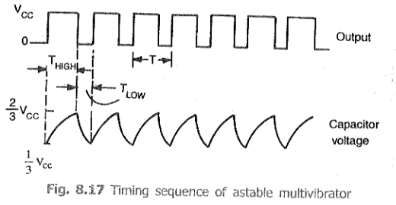
555 Timer - Astable Multivibrator
Working Principle
While charging, the capacitor charges through the resistors R1 and R2. Therefore the charging time constant is (R_{A} + R_{B}) C as the total resistance in the charging path is R_{A} + R_{B}. While discharging, the capacitor discharges through the resistor R_{B} only. Hence the discharge time constant is R_{B} C.

Slide 32
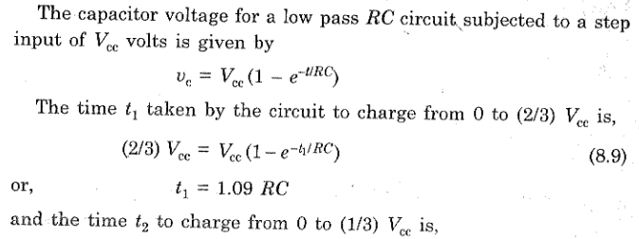
555 Timer - Astable Multivibrator
Analysis

Slide 33
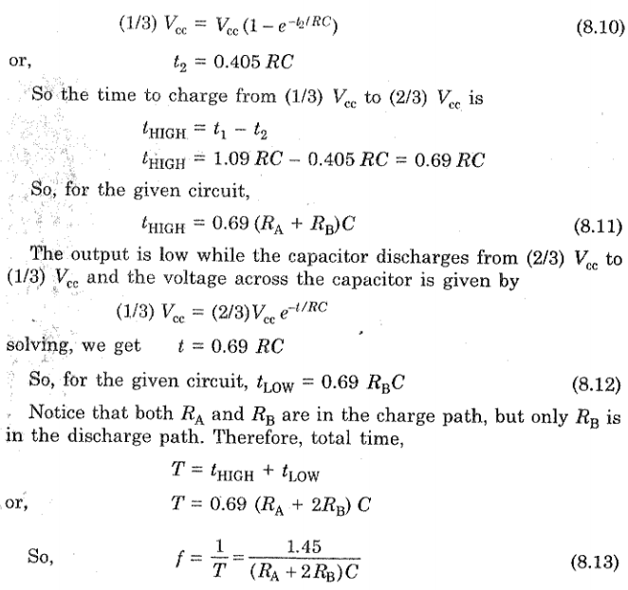
555 Timer - Astable Multivibrator
Analysis

Slide 34
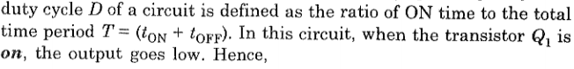
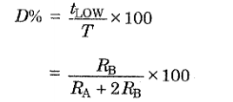
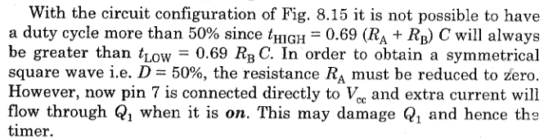
555 Timer - Astable Multivibrator
Analysis

Slide 35
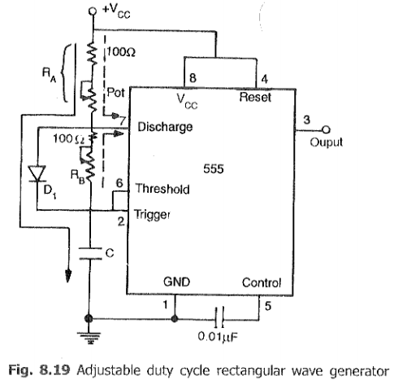
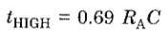
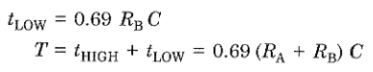
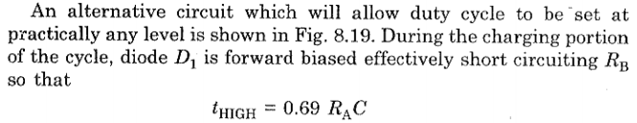
555 Timer - Astable Multivibrator
Square wave Generation

Slide 36
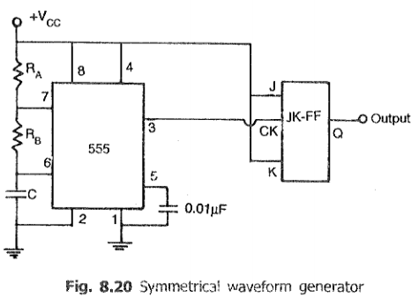
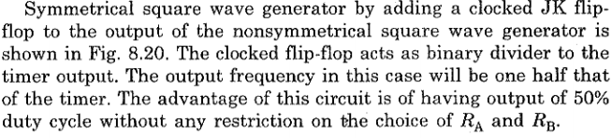
555 Timer - Astable Multivibrator
Square wave Generation

Slide 37
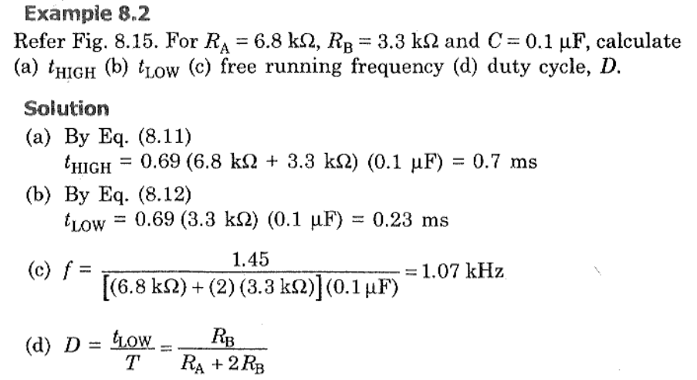
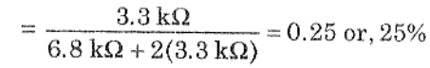
555 Timer - Astable Multivibrator
Square wave Generation

Slide 38
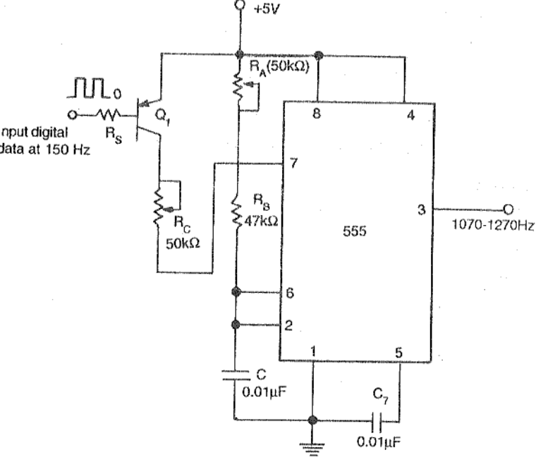
555 Timer - Astable Multivibrator Applications
FSK Generator

Slide 39
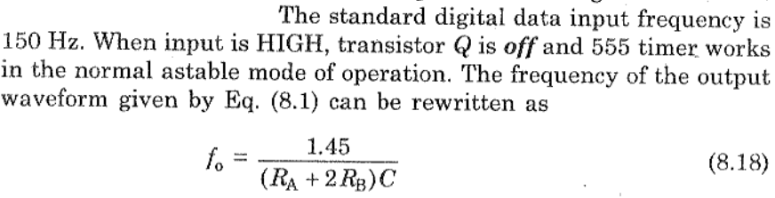
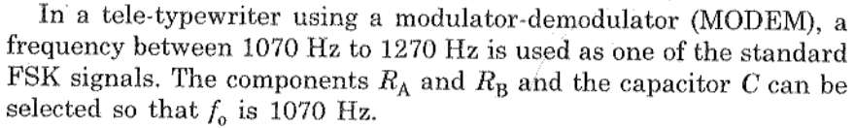
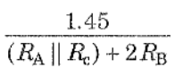
555 Timer - Astable Multivibrator Applications
FSK Generator

Slide 40
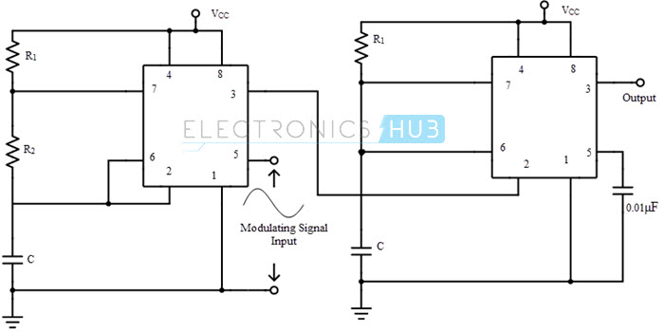
555 Timer - Astable Multivibrator Applications
Pulse Position Modulator

Slide 41
555 Timer - Astable Multivibrator Applications
Pulse Position Modulator
The threshold voltage for the first IC 555, which is determined by the control voltage (modulating signal), is changed to UTL (Upper Threshold Level) and is given by
UTL = 2/3 VCC + VMOD
As the threshold voltage changes with respect to the applied modulating signal, the width of the pulse changes and the hence the time delay is varied. As this pulse width modulated signal is applied to the trigger of the second IC, there will be no change in either amplitude or width of the output pulse but only the position of the pulse is changed.

Slide 42
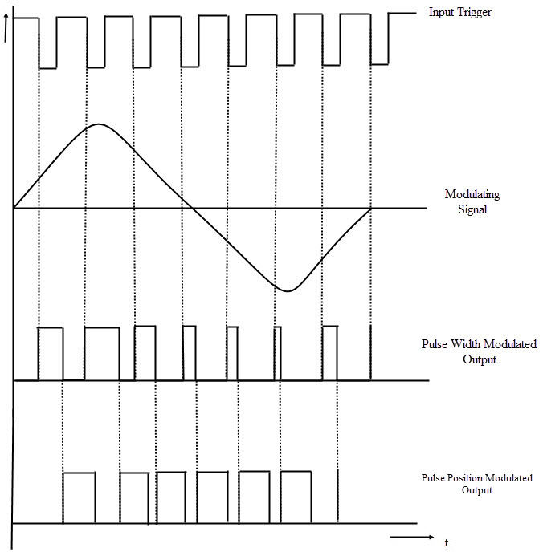
555 Timer - Astable Multivibrator Applications
Pulse Position Modulator

Slide 43
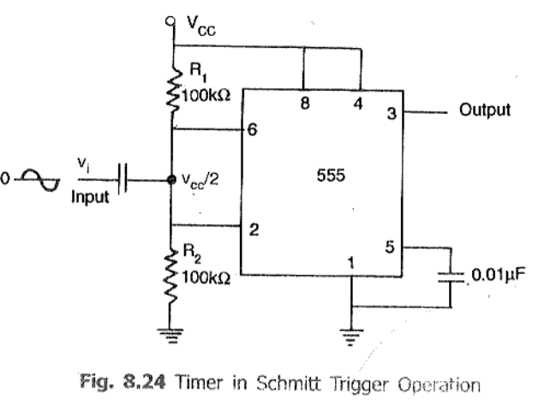
555 Timer - Astable Multivibrator Applications
Schmitt Trigger

Slide 44
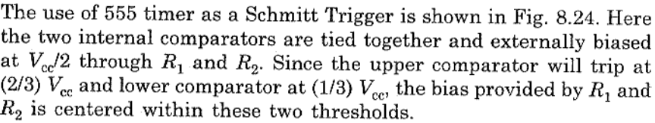
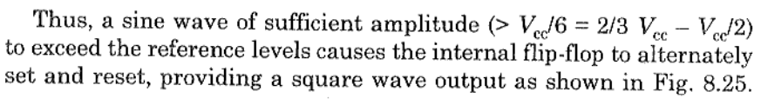
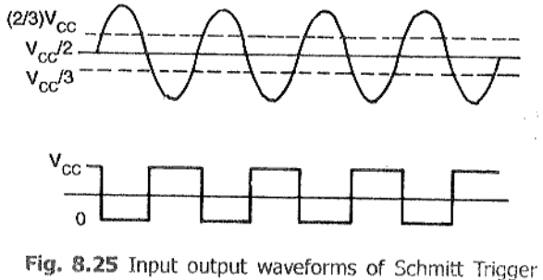
555 Timer - Astable Multivibrator Applications
Schmitt Trigger

Slide 45
Voltage Regulators
Definition:
Voltage regulators are integrated circuits designed to regulate the voltage at their input to a constant, fixed voltage at their output, irrespective of changes in load current or input voltage.
Types of voltage regulators
The two categories include:
1. Series/Linear voltage regulators (Fixed or Variable)
2. Switching voltage regulators

Slide 46
Voltage Regulators
1. Series/Linear voltage regulators (Fixed or Variable)
Use the principles of voltage dividers to transform the voltage at their input to the desired voltage at their output.
They employ a feedback loop that automatically varies the resistance in the system to counter the effect of variations in the load impedance and input voltage, all to ensure the output voltage is kept constant.
Typical implementations of linear voltage regulators involve the use of FETs as one side of a voltage divider with a feedback loop connected to the gate of the transistor, driving it as required to ensure consistency in the output voltage.
Some popular examples of linear voltage regulators include the 78xx (e.g L7805(5v), L7809(9V)) series of voltage regulators.

Slide 47
Voltage Regulators
1. Series/Linear voltage regulators (Fixed or Variable)
Pros
1. Simple and easy to design and implement
2. Generates a lower amount of EMI and noise
3. Fast response time to changes in load current or input voltage conditions
4. Low ripple voltage at the output
Cons
1. Low efficiency as a large amount of electrical energy is wasted as heat
2. Drop-out voltage makes them a bad choice for low power applications
3. Occupy more space on PCB due to their need for heat sinks
4. Low efficiency as a large amount of electrical energy is wasted as heat
5. Drop-out voltage makes them a bad choice for low power applications
6. Occupy more space on PCB due to their need for heat sinks

Slide 48
Voltage Regulators
2. Switching voltage regulators
Switching voltage regulators are super-efficient regulators used in scenarios where power loss, as in linear regulators, cannot be condoned.
The voltage regulation mechanism in switching voltage regulators involves rapidly switching an element connected in series with an energy storage component (capacitor or inductor) to periodically interrupt the flow of current and transform the voltage from one value to the other.
Unlike in linear voltage regulators, the switching element is either in a fully conducting or switched-off state.
It dissipates no power and allows the regulator to attain a high level of efficiency beyond that of the linear regulators.

Slide 49
Voltage Regulators
2. Switching voltage regulators
Pros
Small size
High efficiency
They can provide an output voltage that is greater than or less than the input voltage
Fits low power applications
Cons
Complicated design
Requires more additional components
Expensive
High EMI and noise generation rates that could affect product certification if not properly managed
High output voltage ripple
Slower transient recovery time compared to linear regulators

Slide 50
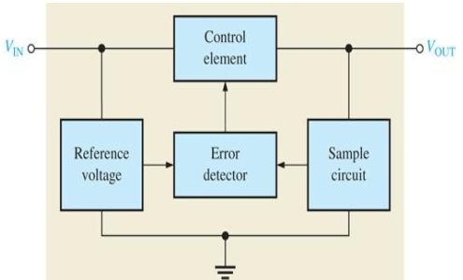
Voltage Regulators
1. Series/Linear voltage regulators (Fixed or Variable)
Control element in series with load between input and output.
Output sample circuit senses a change in output voltage.
Error detector compares sample voltage with reference voltage → causes control element to compensate in order to maintain a constant output voltage .

Slide 51

Voltage Regulators
1. Series/Linear voltage regulators (Fixed or Variable)

Slide 52


Voltage Regulators
1. Series/Linear voltage regulators (Fixed or Variable)
The resistor R1 and R2 sense a change in the output voltage and provide a feedback voltage. The error detector compares the feedback voltage with a Zener diode reference voltage.
The resulting difference voltage causes the transistor Q₁ controls the conduction to compensate the variation of the output voltage.
The output voltage will be maintained at a constant value of
The transistor Q1 is the series control element. Zener diode provides the reference voltage.
Since Q1 is an npn transistor (Emitter Follower), Vo is found as

Slide 53
Voltage Regulators
1. Series/Linear voltage regulators (Fixed or Variable)
The response of the pass-transistor to a change in load resistance as follows:
If load resistance increases, load voltage also increases.
Since the Zener voltage is constant, the increase in Vo causes VBE to decrease.
The decrease in VBE reduces conduction through the pass- transistor, so load current decreases.
This offsets the increase in load resistance, and a relatively constant load voltage is maintained .

Slide 54


Voltage Regulators
Fixed voltage regulators
The fixed voltage regulator has an unregulated dc input voltage Vi applied to one input terminal, a regulated output dc voltage Vo from a second terminal, and the third terminal connected to ground
The series 78XX regulators are the three-terminal devices that provide a fixed positive output voltage.

Slide 55


Voltage Regulators
Fixed voltage regulators
C₁ is to reduce Inductive effects
C₂ is to improve Transient effects

Slide 56

Voltage Regulators
Fixed voltage regulators
An unregulated input voltage Vi is filtered by a capacitor C1 and connected to the IC’s IN terminal.
The IC’s OUT terminal provides a regulated +12 V, which is filtered by capacitor C2.
The third IC terminal is connected to ground (GND) .
Positive-Voltage Regulators in the 78XX Series

Slide 57


Voltage Regulators
Fixed Negative voltage regulators
The series 79XX regulators are the three-terminal IC regulators that provide a fixed negative output voltage

Slide 58
Voltage Regulators
Characteristics
Output voltage (or voltage range)
Output current
Input voltage range
Operating temperature range
Drop-out voltage
Line regulation
Line regulation is the ability of the power supply to maintain its specified output voltage over changes in the input line voltage. It is expressed as percent of change in the output voltage relative to the change in the input line voltage.
Load Regulation
Load regulation is the ability of the power supply to maintain its specified output voltage given changes in the load. This does not mean the tolerance applies when there are sudden changes in load, it means over the permissible load range the regulation can change by this amount.

Slide 59
Voltage Regulators
Ripple Rejection
The ripple rejection ratio is the ratio of the ripple voltage that appears on the output voltage when the ripple voltage component (noise) is superimposed on the input voltage to the input ripple voltage.
The larger this value, the smaller the ripple component that appears in the output.
The Monolithic regulators has in-built circuits for,
Over-Current Protection
Thermal Overload Protection

Slide 60

Voltage Regulators
Schematic of 7805 IC

Slide 61

Voltage Regulators
Electrical Characteristics

Slide 62

Voltage Regulators
7805 as Current Source

Slide 63


Voltage Regulators
7805 as Current Source

Slide 64

Voltage Regulators
7805 as Boosting IC Regulator Output Current

Slide 65

Voltage Regulators
7805 as Boosting IC Regulator Output Current

Slide 66


Voltage Regulators
7805 as Boosting IC Regulator Output Current

Slide 67

Voltage Regulators
7805 as Boosting IC Regulator Output Current

Slide 68

Voltage Regulators
7805 as Boosting IC Regulator Output Current

Slide 69


Voltage Regulators
7805 as Boosting IC Regulator Output Current

Slide 70

Voltage Regulators
7805 as Adjustable Voltage Regulator

Slide 71

Voltage Regulators
7805 as Adjustable Voltage Regulator

Slide 72
Voltage Regulators
7805 as Adjustable Voltage Regulator

Slide 73

Voltage Regulators
7805 as Adjustable Voltage Regulator

Slide 74

Voltage Regulators
7805 as Dual Voltage Supply
LM340 → +15V; LM320 → -15V.
D₁ and D₂ to protect regulator against Short Circuit
D₃ and D₄ to provide protection against turn on both the regulators at the same time.
During operation D₃ and D₄ are in reverse biased condition

Slide 75
Voltage Regulators
723 General Purpose Voltage Regulator
Disadvantages of fixed voltage regulator:
Do not have the shot circuit
Output voltage is not adjustable
These limitations can be overcomes in IC723.
Features of IC723:
Unregulated dc supply voltage at the input between 9.5V & 40V
Adjustable regulated output voltage between 2 to 3V.
Maximum load current of 150 mA (ILmax = 150mA).
With the additional transistor used, ILmax upto 10A is obtainable.
Positive or Negative supply operation
Internal Power dissipation of 800mW.
Built in short circuit protection.
Very low temperature drift.
High ripple rejection.

Slide 76



Voltage Regulators
723 General Purpose Voltage Regulator

Slide 77

Voltage Regulators
723 General Purpose Voltage Regulator
The simplified functional block diagram can be divided in to 4 blocks.
Reference generating block
Error Amplifier
Series Pass transistor
Circuitry to limit the current

Slide 78
Voltage Regulators
723 General Purpose Voltage Regulator
1. Reference Generating block:
The temperature compensated Zener diode, constant current source & voltage reference amplifier together from the reference generating block. The Zener diode is used to generate a fixed reference voltage internally. Constant current source will make the Zener diode to operate at affixed point & it is applied to the Non – inverting terminal of error amplifier. The Unregulated input voltage ±Vcc is applied to the voltage reference amplifier as well as error amplifier.
2. Error Amplifier:
Error amplifier is a high gain differential amplifier with 2 input (inverting & Non-inverting). The Non-inverting terminal is connected to the internally generated reference voltage. The Inverting terminal is connected to the full regulated output voltage.

Slide 79
Voltage Regulators
723 General Purpose Voltage Regulator
3. Series Pass Transistor:
Q₁ is the internal series pass transistor which is driven by the error amplifier. This transistor actually acts as a variable resistor & regulates the output voltage. The collector of transistor Q₁ is connected to the Un-regulated power supply. The maximum collector voltage of Q₁ is limited to 36Volts. The maximum current which can be supplied by Q₁ is 150mA.
4. Circuitry to limit the current:
The internal transistor Q₂ is used for current sensing & limiting. Q₂ is normally OFF transistor. It turns ON when the IL exceeds a predetermined limit.

Slide 80



Voltage Regulators
723 General Purpose Voltage Regulator (LOW)

Slide 81

Voltage Regulators
723 General Purpose Voltage Regulator (LOW)

Slide 82



Voltage Regulators
723 General Purpose Voltage Regulator (HIGH)

Slide 83

Voltage Regulators
723 General Purpose Voltage Regulator - with Current Limit Protection

Slide 84



Voltage Regulators
723 General Purpose Voltage Regulator - with Current Limit Protection

Slide 85

Voltage Regulators
723 General Purpose Voltage Regulator - with Current Foldback

Slide 86


Voltage Regulators
723 General Purpose Voltage Regulator - with Current Foldback

Slide 87


Voltage Regulators
723 General Purpose Voltage Regulator - with Current Foldback

Slide 88

Voltage Regulators
723 General Purpose Voltage Regulator - with Current Boosting

Slide 89

Voltage Regulators
723 General Purpose Voltage Regulator - with Current Boosting

Slide 90

Video amplifier

Slide 91
Type 733 Video Amplifier:
Two stage differential input, output
Wideband video amplifier
Series shunt feedback(Wide bandwidth with low phase distortion & high gain stability)
Emitter follower outputs(High current & low impedance)
Memory element drivers, pulse amplifier and wideband linear gain stages

Slide 92


Pin Diagram

Slide 93
Features and applications
120 MHz bandwidth
250 kohm input resistance
Selectable gains of 10, 100, 400
No frequency compensation
High common mode rejection ratio at high frequencies
Magnetic tape systems,Disk file memories,Thin and thick film memories,Woven and plated wire memories,Wide band video amplifiers

Slide 94


Slide 95

Frequency response characteristics
External gain adjustment(series feedback in first stage)
Interconnecting resistor taps

Slide 96


Slide 97
https://www.circuitstoday.com/ic-voltage-regulators
https://learnabout-electronics.org/PSU/psu23.php

